Slide 1

Implementation of Web Portal 1.0
Project Roadmap
Date | 20-JUN-2022
Business Contact | NARMADHA
Project Reference | PR-200622
Application | Web based admin portal
Tech Stack | PHP, MYSQL, AWS

Slide 2
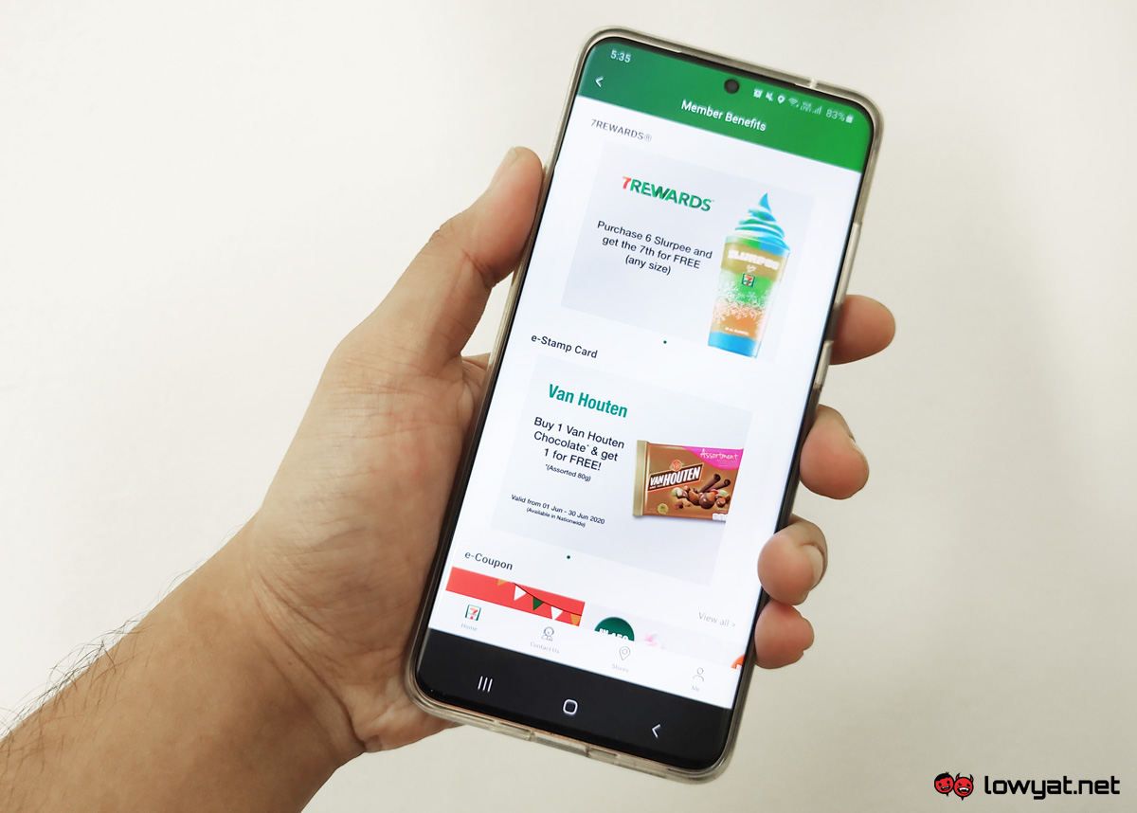
Project Goal & Vision
Scope of Work
Vendor Evaluation & Criteria
Approach / Methodology
Project Timeline
Implementation Plan
A G E N D A
Proposed Team Structure
Cost Monitoring
Technical Stack
Escalation Mechanism
Conclusion

Slide 3

PROJECT VISION
To Analyze, Develop and Implement - Web based admin Portal for Internal User admin management
Business Process Study
Setup AWS Platform
Design & Development Application
Support & Maintenance

Slide 4
PROJECT SCOPE
The project scope is to emphasize and enabling Web portal for User administration with salient features as below.,
New User Registration
User & Role management
Customer management
eKYC Validation Screening / Settings
Credit and Refunds Processing
Claims Backoffice processing
Setting up Notifications
Reports management
Dashboard View management
Export Member & Claims data

Slide 5
VENDOR EVALUATION
Vendor assessment has been carried out using Weighted-Point method and below are the key criteria’s for evaluation
Business (Presence / Stability / Integrity)
Technical Competency (Capability / Delivery)
SOW & Agreements
Quality & Service
Detailed evaluation of multiple (sample) vendors has been carried out across different criteria’s in the attached sheet

Slide 6
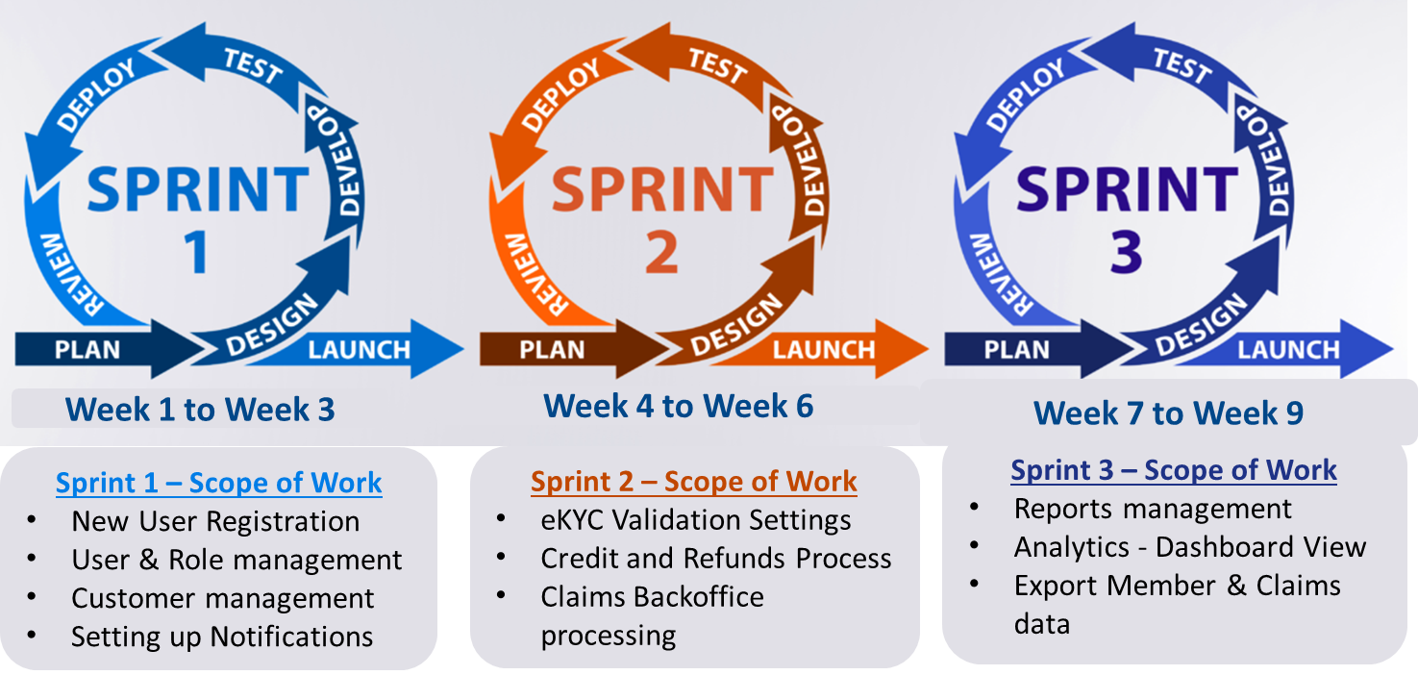
APPROACH
DELIVERY MODEL
Business Study & Platform Setup
Setup Environment for Develop, Test and Production
Implementation of Web Application
Design the Front end and Back-end architecture
Unit, System & Pre-UAT Testing
Application packaging and deployment into Test
UAT and Sign off
Analyze the business goals and needs
Requirements Gathering & Solutioning Alignment
Define User , Role and Accessibility controls
Development of Web application using PHP and MYSQL
Application Hosting / Implementation to Production
Agile Delivery Model

Slide 7
ROLL OUT PLAN & DELIVERABLES
Project Phase | Scope of Deliverables
Discovery | Process Study / Gap Analysis ; BRD Sign off
Design | High Level Design Document; Technical Architecture Tech Design Document
Development | Source Code development; Code Review Global and Local components setup / code handling Error Handling Unit Testing
Testing | Functional Test Cases / scripts ; Test case Execution Results Defect management and Test summary report
UAT | Business Test Cases / scripts; UAT Sign off
Deployment | Deployment setup Configuration management User manual Perform deployment of Code / Configurations
GO-LIVE | Prod Deployment Run book; Release specifications Deployment documents; Project Closure Sign off
Key Pointers
This Overall Roll out Plan will be internally accommodated with Sprint wise plan as per Slide 6.
Every Sprint will undergo all the deliverables within sprint timeline of 3 weeks across design, development and testing stages

Slide 8
PROPOSED TEAM STRUCTURE
Management/ Sponsor
Project Delivery
Business Sponsor
ABC
XYZ
Project Manager
Project Manager
XYZ1
Execution
Tech Lead
Developers
Change Management
Business Analyst
ABC1
3 Developers
XYZ2
XYZ3
Testing / Quality
Business Users
Business Managers
2 Testers
XYZ4
XYZ5
Internal IT – Business / Vendor management
Business
Vendor IT
Internal IT

Slide 9
TECHNICAL STACK
Expertise in Full Stack development
Experience in API Integrations , PHP and React.js
Experience in Cloud platform implementations
Expertise in web application hosting
Data analytics and dashboards

Slide 10
PROJECT COST MONITORING
NOTE – Attached Sheet contains the details of Cost Planning, tracking and Overall Project Dashboard view

Slide 11



PROJECT STATUS SUMMARY
Vendor / Internal IT
Business
Sprint 1
Procurement of software (if any)
Confirm requirements
Development
Quality assurance
User Training
Project Planning
UAT
Sprint 1 – System LIVE/Production Rollout
Operational LIVE
Procurement of hardware
Project initiation
Sprint 2
Installation & Configuration
Confirm requirements
Development
Quality assurance
User Training
UAT
Sprint 2 – System LIVE/Production rollout
Operational LIVE
Sprint 3
Test case development
Confirm requirements
Development
(in progress)
Quality assurance
User Training
UAT
Sprint 3 – System LIVE/Production rollout
Operational LIVE
Legend:
Internal planning and execution of plans.
Training and user acceptance testing (“UAT”) which requires Business involvement.
Requires Business involvement.
Project implementation.
Go live.
Completed.
Work In Progress

Slide 12



GOVERNANCE & STEERING CO
From IT
Internal /Vendor
Client / Business
Strategic Planning
Executive Review
Dispute Resolution
Relationship Management
Monthly
Strategic Direction
Dispute Resolution
Escalation point for issues
STEERING COMMITTE
Delivery
Head
Executive Sponsor
Steering Committee
Escalation Level 2
Weekly
Performance review
Escalated issues
Commercial aspects
New scope of work (SOW)
Issue Resolution
Approvals
Financial Management
Change Control
Contract amendment
MANAGEMENT COMMITTE
Project
Manager
Project
Director
Project Management
Escalation Level 1
Planning & Tracking
Code management
Issue Resolution
Approvals
Code baseline and deployments
Daily / Weekly
Performance review
Issue logging / tracking
Escalated issues
Project Status Reporting
WORKING COMMITTE
Technical
Lead/Team
PM &
Users
Stand-up Meeting

Slide 13
CONCLUSION
With my expertise in Business & Digital transformation which involves System / Product implementation, Test & QA Engineering, Delivery & Portfolio management - It has always been ensured to enable the business with great success and enhanced customer satisfaction.
Thank You
Narmadha H

